Slide 1
Presentation on Analog Communication Topic: Blanking and Synchronizing Pulses
Submitted to:
Md. Imran Hossain
Assistant Professor
Department of ICT
Comilla University
Submitted by :
Md .Inzamamul Haque
ID :11809017
Session: 2017-18
Department of ICT
Comilla University

Slide 2
INTRODUCTION TO Blanking
The composite video signal contains blanking pulses to make the retrace lines invisible by raising the signal amplitude slightly above the black level (75 per cent) during the time the scanning circuits produce retracs.
The 3 terms about blanking
1.Blanking level
2.Black level
3. white level

Slide 3
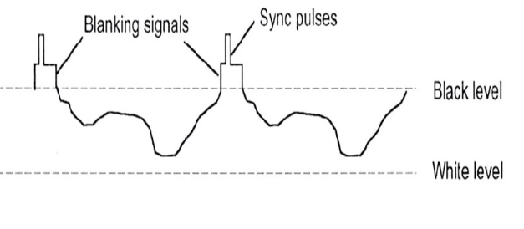
Blanking pulses
The electron beam is analog modulated across the horizontal line .​
The modulation then translate into intensity

Slide 4
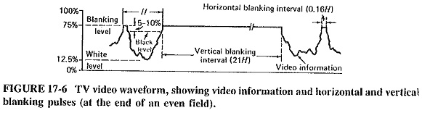
Blanking pulses
The electron beam is analog modulated across the horizontal line .
The modulation then translate into intensity changes in electron beam thus gray scale levels on picture screen

Slide 5
Blanking pulses
Along the video amplifier the voltage may vary 1.25 V to 6.75 V
The Blanking level corresponds to 75% persent of maximum modulation
The black level is 5 to 10 persent below the Blanking level
We have white level at 1.25 V ,Black at 6.25 and the Blanking at 7.5 V
The difference between the blanking level and the black level is known as the setup interval

Slide 6
synchronization pulse:
A pulse used to achieve or maintain synchronism.
A blanking pulse comes first to put the video signal at black level, then a sync pulse comes to start the retrace. This sequence applies to blanking, horizontal and vertical retraces.
Procedure is fundamentally the same as used in blanking pluse insertion

Slide 7
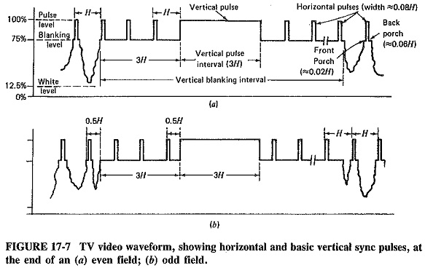
synchronization pulse:

Slide 8
What is the role of sync separator in a TV receiver?
the synchronizing pulse information must be removed from the composite video signal. This is accomplished through the use of a sync separator or sync stripper, which utilizes the composite video signal as an input and generates an output during the presence of a horizontal or vertical sync pulse

Slide 9
Thank you

